Slide 1
Brothers in White Chapel, Inc. Projects

Slide 2
Our Mission
Brothers in White Chapel, Inc. (BIW) will build a chapel at the Pack unit and one at the Luther unit that will be a sanctuary for incarcerated men to gather in a Christian environment to facilitate learning about the transformational love of Jesus that will change their lives and their families, for eternity.
501© 3 non-profit organization

Slide 3
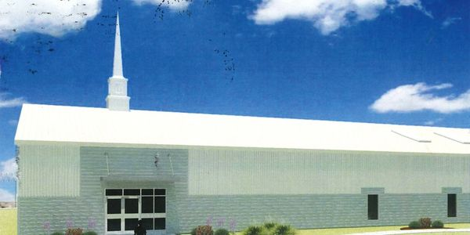
According to Prison Review 2021, there are over 160,000 inmates who are incarcerated in Texas prisons year in and year out costing Texas taxpayers over $3.2 billion every year to house and care for these inmates.
Over 90% of those incarcerated today can expect to return to the free world someday. Of course, we would all hope that those released from prison would then live out their lives as law-abiding citizens but, regrettably, this is often not the case. Upon release, as high as 60%-70% of that population of 160,000 will return to prison within 3 years.
It has been proven that a chapel utilized within a prison reduces recidivism.
Additionally, the purpose of these chapels is to provide an environment that promotes learning prosocial Christian behaviors as well as a life transformation.
This transformation will enable incarcerated men to effectively deal with the challenges they will face in going back into society.
501© 3 non-profit organization

Slide 4
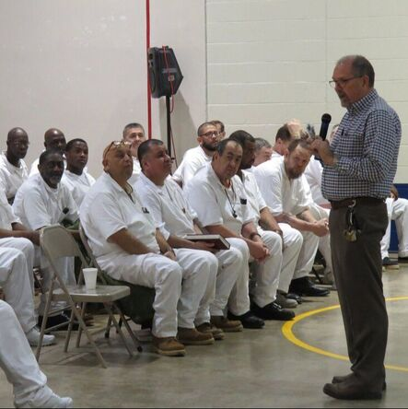
As incarcerated men are transformed through the saving life of Jesus, they become an influence upon fellow incarcerated men resulting in an overall change in the prison culture that promotes prosocial behavior both inside the prison and once released from prison.
Once they leave prison and return to society, those men who participated in this transformative environment, statistically are 60-70% more likely to never return to prison than those who didn’t participate in this chapel environment. This also promotes a break in the cycle of sons following their fathers into prison. These transformed men leave prison as an encouragement and example for their families to follow.
501© 3 non-profit organization

Slide 5
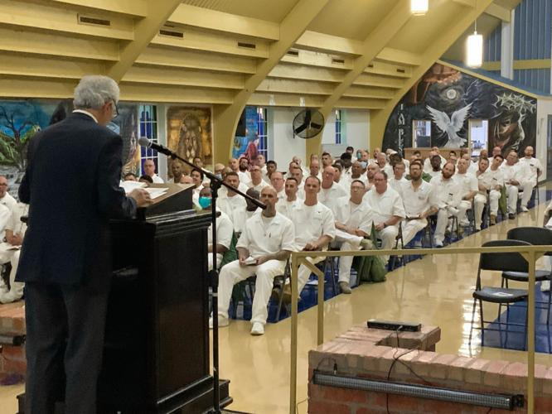
Benefits of the Chapels:
Pack and Luther Units- Navasota, Texas
The chaplain at the Pack unit estimates that an increase of 500 men a year at each unit can receive faith-based training and education with the addition of a chapel. Presently, space limits the number of participants to a maximum of 300 men. Both units house approximately 1200-1500 male inmates meaning that 900-1200 men aren’t reached. While this population remains the same, the faces change greatly. Men are transferred, released, and enter the unit regularly. The impact of chapels is greatly magnified by this exchange of men through the unit.
Jesus said in Matthew 25:36 “…I was in prison and you came to me.”
501© 3 non-profit organization

Slide 6
Estimated Cost to build a chapel
TDCJ does not build prison chapels but allow private funds to do so
Based on recent build of Torres Unit (Hondo) cost was $2 million
Torres is comparable sized unit (1500 men) to Luther and Pack units
Luther and Pack Chapels will accommodate 400+ men for a church service
BIW has engaged an Architect (GLS), initially pro bono, for design and construction mgmt.
Estimated cost= $2 million each chapel based on Torres unit chapel

Slide 7
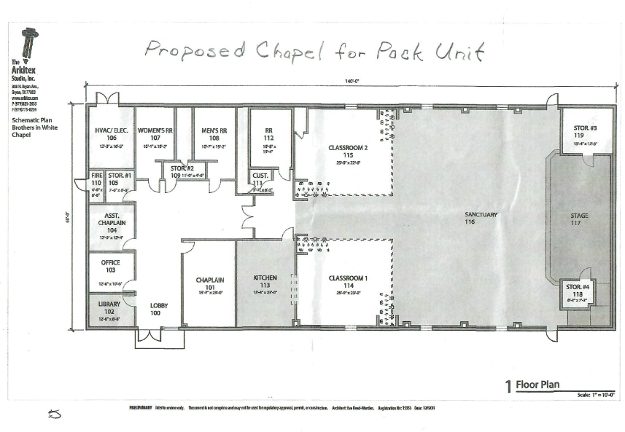
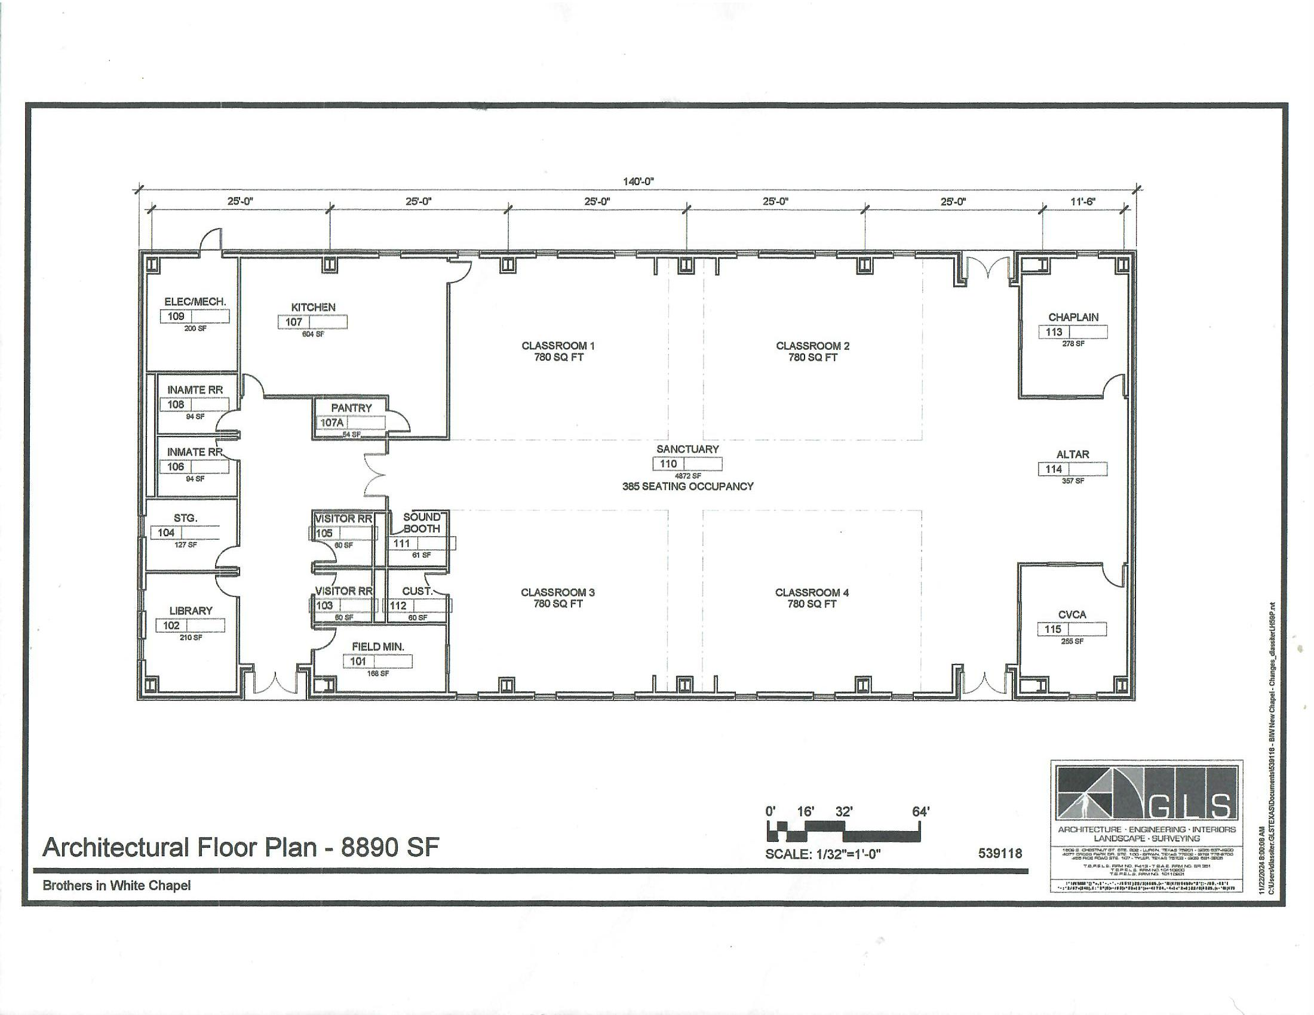
501© 3 non-profit organization

Slide 8
How will we fund these chapels?
Church Endorsements/Donations
Donations from Men in white & families (Pack & Luther)
Donations from Kairos Prison Ministry team members
Community Foundation of the Brazos Valley (CFBV) Brazos Valley Gives
Grants/Endowments
Church meetings/solicitations
Targeting Big Donors
Interest on Accumulated Funds
Total Accumulated Funds to date(Dec. 1, 2024) = $400,300

Slide 9
Estimated timeline for Chapel Funding
Chapel #1: $2million by Year 4 (2027)
Chapel #2: $2 million by end of Year 6 (2029)

Slide 10
Formation History of BIW Chapel
Sept. 2021: BIW Chapel, Inc.(BIW) incorporated in state of Texas
Nov. 2021: BIW designated by IRS as non-profit corporation (87-1994054)
Jan. 2022: First donation $50.00, Began board meetings Began organizing and developing a fund-raising strategy. Counsel with experienced fund-raisers.
Dec. 2022: Accumulated funds= $16,400
Feb. 2023: filed Form 990 to IRS (less than $50k in revenue)
Sept. 2023: Joined as a participant with CFBV &BVG
Oct. 2023: participated with BVG, received approx. $76k
Dec. 2023: Accumulated funds= $140,000
July 2024: Donor provided matching fund = $800,000, $200,000 donated to BIW
Oct. 2024: participated in BVG = $32,000
Dec. 2024: Accumulated funds = $400,000

Slide 11
Fund-Raising Results End of Year 2 Dec. 2024

Slide 12
Donor Breakdown Dec. 1, 2024

Slide 13
BIW Balance Sheet Dec. 1, 2024

Slide 14
Why Build a Chapel?
Promotes a faith-based environment leading to a life-long transformation and faith in Jesus Christ
Helps to greatly reduce recidivism
Can reduce tax burden to Texas taxpayers
Improve pro-social behaviors within offenders in prison
Provides a sanctuary for men to learn about faith-based programs in a safe environment
Increase the reach to more inmates than without a chapel

Slide 15
Tax-deductible donations may be mailed to:
Brothers in White Chapel Inc. P.O. Box 261 Wellborn, Texas 77881
or visit www.biwchapel.com
Contacts:
George Faulkner, President gfaulkner70@suddenlink.net
Kelly Gerland, Vice-President Kellywayne01@gmail.com
James Conley, Treasurer James.conley.1956@gmail.com
Glen Wise, Secretary glendalewise@gmail.com
Website: www.biwchapel.com

Slide 16
TDCJ Letter of Chapel Support

Slide 17
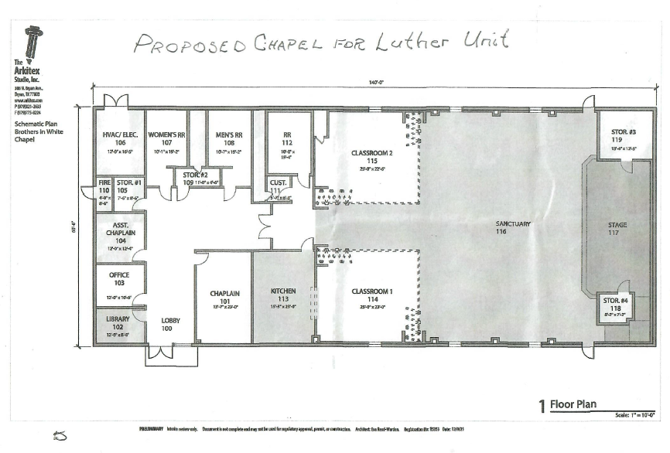
501© 3 non-profit organization

